Slide 1
flutter
PURE FIT
PURE FIT
By Group 3
depi.gov.eg

Slide 2

01
INTRODUCTION
02
PROBLEM
LIST OF CONTENTS
03
SOLUTION
04
CORE FEATURES
05
TECHNICAL ARCHITECTURE
06
SYSTEM UI

Slide 3
PureFit is a fitness app designed to help users achieve their health goals.
Features real-time step tracking, personalized exercise plans, and an AI-powered fitness coach.
Integrates tech to deliver a seamless user experience for tracking fitness and wellness goals.
introducing
OVERVIEW

Slide 4
01
Lack of Real-Time Activity Tracking
project
02
Generic Workout Plans
PROBLEM
03
Inconsistent Goal Tracking
04
Fragmented Health Solutions

Slide 5


SOLUTION
Integrated Pedometer tracks steps in real-time, providing instant feedback on daily movement.
Uses Gemini API to offer AI-powered, personalized workout plans tailored to each user’s fitness level, goals, and preferences.
Simplifies goal management by offering a comprehensive view of all health metrics in one place.
Combines step tracking, AI-powered workout plans, nutrition guidance, water intake monitoring, and sleep management—all in one app.

Slide 6
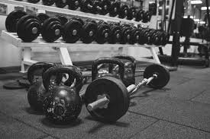
01
Real-time Step Tracking
02
Customizable Exercise Programs
project
03
Comprehensive Goal Tracking
CORE FEATURES
04
Sleeping Alarms and Reminders
05
Multi-language Support

Slide 7
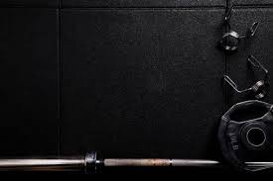
Uses Pedometer for accurate step counting.
Enables users to monitor progress in real-time.
Feature1
LACK OF REAL-TIME ACTIVITY TRACKING

Slide 8


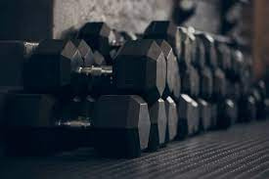
Personalized workout plans tailored to individual fitness levels.
AI-based recommendations using Gemini API for workouts and nutrition.
Feature2
CUSTOMIZABLE EXERCISE PROGRAMS

Slide 9

Feature3
Tracks steps, water intake, calorie consumption, and more.
Allows users to set and track personalized fitness goals.
COMPREHENSIVE GOAL TRACKING

Slide 10


Alarms managed via
by alarm_manager_plus package
Feature4
SLEEPING ALARMS AND REMINDERS
Includes sleep alarms for improved rest patterns.

Slide 11

Feature5
MULTI-LANGUAGE SUPPORT
Built-in localization using Flutter Localization.
Provides users with a more accessible, global user experience.

Slide 12




Tech
TECHNICAL ARCHITECTURE
Flutter
PostMan
Gemini AI

Slide 13
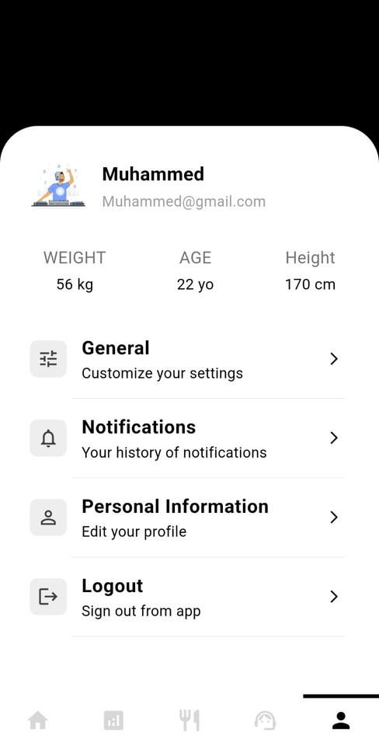
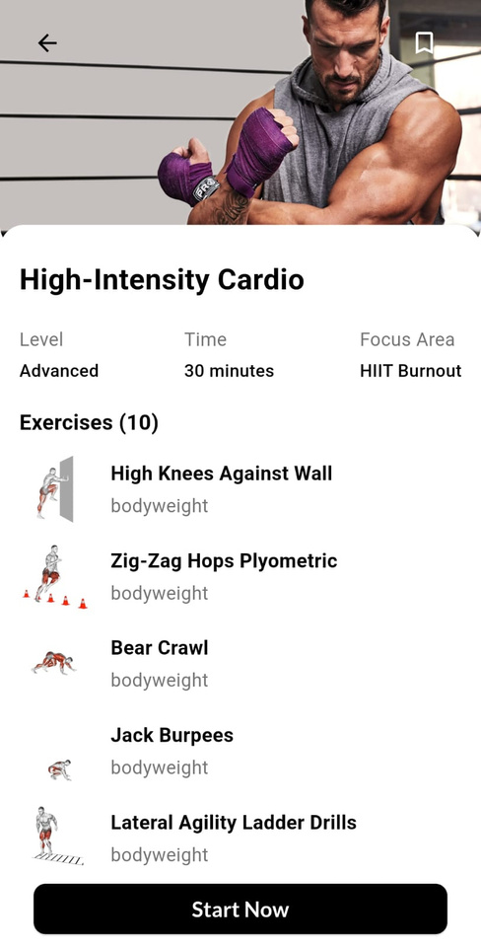
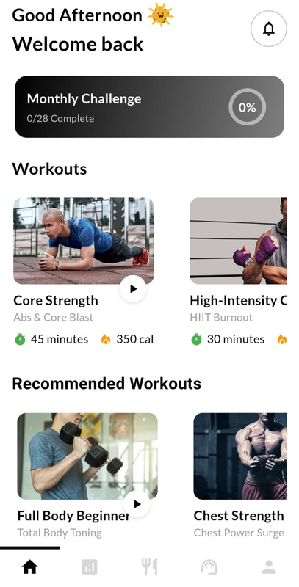
Design
SYSTEM UI

Slide 14
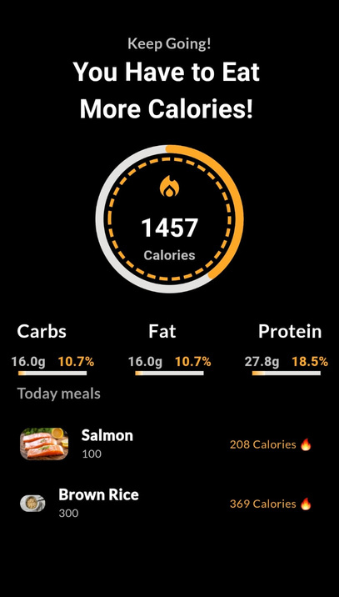
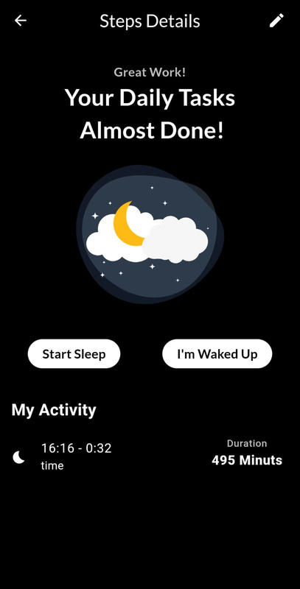
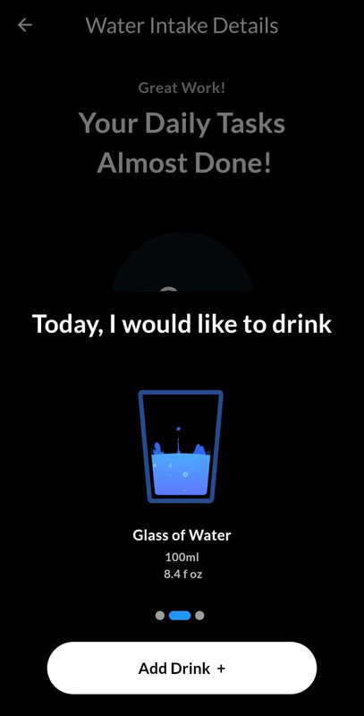
Design
SYSTEM UI
Nutrition Screen
Sleep Tracker
Water InTake Screen

Slide 15
THANK YOU
for Watching

